Slide 1
Single Table (Query)
Arif Muntasa

Slide 2
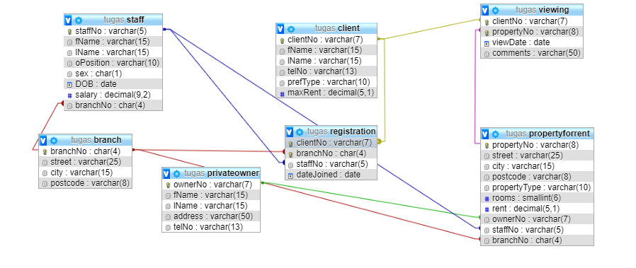
ER-Model

Slide 3
Tables
Branch
Client
PrivateOwner
ProperyForRent
Registration
Staff
Viewing

Slide 4
Branch
CREATE TABLE `branch` (
`branchNo` char(4) NOT NULL,
`street` varchar(25) NOT NULL,
`city` varchar(15) NOT NULL,
`postcode` varchar(8) NOT NULL
);

Slide 5
Insert Record into Branch Table
INSERT INTO `branch` (`branchNo`, `street`, `city`, `postcode`) VALUES
('B002', '56 Clover Dr', 'London', 'NW10 6EU'),
('B003', '163 Main St', 'Glasgow', 'G11 9QX'),
('B004', '32 Manse Rd', 'Bristol', 'BS99 1NZ'),
('B005', '22 Deer Rd', 'London', 'SW1 4EH'),
('B007', '16 Argyll St', 'Aberdeen', 'AB2 3SU');

Slide 6
Client
CREATE TABLE `client` (
`clientNo` varchar(7) NOT NULL,
`fName` varchar(15) NOT NULL,
`lName` varchar(15) NOT NULL,
`telNo` varchar(13) NOT NULL,
`prefType` varchar(10) NOT NULL,
`maxRent` decimal(5,1) NOT NULL
);

Slide 7
Insert Record into Client Table
INSERT INTO `client` (`clientNo`, `fName`, `lName`, `telNo`, `prefType`, `maxRent`) VALUES
('CR56', 'Aline', 'Stewart', '0141-848-1825', 'Flat', '350.0'),
('CR62', 'Mary', 'Tregar', '01224-196720', 'Flat', '600.0'),
('CR74', 'Mike', 'Ritchie', '01475-392178', 'House', '750.0'),
('CR76', 'John', 'Kay', '0207-774-5632', 'Flat', '425.0');

Slide 8
privateowner
CREATE TABLE `privateowner` (
`ownerNo` varchar(7) NOT NULL,
`fName` varchar(15) NOT NULL,
`lName` varchar(15) NOT NULL,
`address` varchar(50) NOT NULL,
`telNo` varchar(13) NOT NULL
) ;

Slide 9
Insert Record into PrivateOwner Table
INSERT INTO `privateowner` (`ownerNo`, `fName`, `lName`, `address`, `telNo`) VALUES
('CO40', 'Tina', 'Murphy', '63 Well St, Glasgow G42', '0141-943-1728'),
('CO46', 'Joe', 'Keogh', '2 Fergus Dr, Aberdeen AB2 7SX', '01224-861212'),
('CO87', 'Carol', 'Farrel', '6 Achray St, Glasgow G32 9DX', '0141-357-7419'),
('CO93', 'Tony', 'Shaw', '12 Park Pl, Glasgow G4 0QR', '0141-225-7025');

Slide 10
propertyforrent
CREATE TABLE `propertyforrent` (
`propertyNo` varchar(8) NOT NULL,
`street` varchar(25) NOT NULL,
`city` varchar(15) NOT NULL,
`postcode` varchar(8) NOT NULL,
`propertyType` varchar(10) NOT NULL,
`rooms` smallint(6) NOT NULL,
`rent` decimal(5,1) NOT NULL,
`ownerNo` varchar(7) NOT NULL,
`staffNo` varchar(5) DEFAULT NULL,
`branchNo` char(4) NOT NULL
);

Slide 11
Insert Record into PropertyForRent Table
INSERT INTO `propertyforrent` (`propertyNo`, `street`, `city`, `postcode`, `propertyType`, `rooms`, `rent`, `ownerNo`, `staffNo`, `branchNo`) VALUES
('PA14', '16 Holhead', 'Aberdeen', 'AB7 5SU', 'House', 6, '650.0', 'CO46', 'SA9', 'B007'),
('PG16', '5 Novar Dr', 'Glasgow', 'G12 9AX', 'Flat', 4, '450.0', 'CO93', 'SG14', 'B003'),
('PG21', '18 Dale Rd', 'Glasgow', 'G12', 'House', 5, '600.0', 'CO87', 'SG37', 'B003'),
('PG36', '2 Manor Rd', 'Glasgow', 'G32 4QX', 'Flat', 3, '375.0', 'CO93', 'SG37', 'B003'),
('PG4', '6 Lawrence St', 'Glasgow', 'G11 9QX', 'Flat', 3, '350.0', 'CO40', NULL, 'B003'),
('PL94', '6 Argyll St', 'London', 'NW2', 'Flat', 4, '400.0', 'CO87', 'SL41', 'B005');

Slide 12
registration
CREATE TABLE `registration` (
`clientNo` varchar(7) NOT NULL,
`branchNo` char(4) NOT NULL,
`staffNo` varchar(5) NOT NULL,
`dateJoined` date NOT NULL
);

Slide 13
Insert Record into registration Table
INSERT INTO `registration` (`clientNo`, `branchNo`, `staffNo`, `dateJoined`) VALUES
('CR56', 'B003', 'SG37', '2000-04-11'),
('CR62', 'B007', 'SA9', '2000-03-07'),
('CR74', 'B003', 'SG37', '1999-11-16'),
('CR76', 'B005', 'SL41', '2001-01-02');

Slide 14
Staff
CREATE TABLE `staff` (
`staffNo` varchar(5) NOT NULL,
`fName` varchar(15) NOT NULL,
`lName` varchar(15) NOT NULL,
`oPosition` varchar(10) NOT NULL,
`sex` char(1) DEFAULT NULL,
`DOB` date DEFAULT NULL,
`salary` decimal(9,2) NOT NULL,
`branchNo` char(4) NOT NULL
)

Slide 15
Insert Record into Staff Table
INSERT INTO `staff` (`staffNo`, `fName`, `lName`, `oPosition`, `sex`, `DOB`, `salary`, `branchNo`) VALUES
('SA9', 'Mary', 'Howe', 'Assistant', 'F', '1970-02-19', '9000.00', 'B007'),
('SG14', 'David', 'Ford', 'Supervisor', 'M', '1958-11-24', '18000.00', 'B003'),
('SG37', 'Ann', 'Beech', 'Assistant', 'F', '1960-10-11', '12000.00', 'B003'),
('SG5', 'Susan', 'Brand', 'Manager', 'F', '1940-06-03', '24000.00', 'B003'),
('SL21', 'John', 'White', 'Manager', 'M', '1945-10-01', '30000.00', 'B005'),
('SL41', 'Julie', 'Lee', 'Assistant', 'F', '1965-06-13', '9000.00', 'B005');

Slide 16
Viewing
CREATE TABLE `viewing` (
`clientNo` varchar(7) NOT NULL,
`propertyNo` varchar(8) NOT NULL,
`viewDate` date NOT NULL,
`comments` varchar(50) DEFAULT NULL
)

Slide 17
Insert Record into Viewing Table
INSERT INTO `viewing` (`clientNo`, `propertyNo`, `viewDate`, `comments`) VALUES
('CR56', 'PA14', '2001-05-24', 'too small'),
('CR62', 'PA14', '2001-05-14', 'no dining room'),
('CR56', 'PG36', '2001-04-28', NULL),
('CR56', 'PG4', '2001-05-26', NULL),
('CR76', 'PG4', '2001-04-20', 'too --ote');

Slide 18
Primary Key of Parent Tables
ALTER TABLE `branch`
ADD PRIMARY KEY (`branchNo`);
ALTER TABLE `client`
ADD PRIMARY KEY (`clientNo`);
ALTER TABLE `privateowner`
ADD PRIMARY KEY (`ownerNo`);

Slide 19
Primary Keys of propertyforrent Table
ALTER TABLE `propertyforrent`
ADD PRIMARY KEY (`propertyNo`),
ADD KEY `Property_Owner_FK` (`ownerNo`),
ADD KEY `Property_Staff_FK` (`staffNo`),
ADD KEY `Property_Branch_FK` (`branchNo`);

Slide 20
Primary Key of Child Table
ALTER TABLE `registration`
ADD PRIMARY KEY (`clientNo`,`branchNo`),
ADD KEY `Regist_Branch_FK` (`branchNo`),
ADD KEY `Regist_Staff_FK` (`staffNo`);

Slide 21
Primary Key of Child Table
ALTER TABLE `staff`
ADD PRIMARY KEY (`staffNo`),
ADD KEY `Staff_Branch_FK` (`branchNo`);

Slide 22
Primary Key of Viewing Table
ALTER TABLE `viewing`
ADD PRIMARY KEY (`propertyNo`,`clientNo`),
ADD KEY `Viewing_Client_FK` (`clientNo`);

Slide 23
Primary and Foreign key of propertyforrent Table
ALTER TABLE `propertyforrent`
ADD CONSTRAINT `Property_Branch_FK` FOREIGN KEY (`branchNo`) REFERENCES `branch` (`branchNo`),
ADD CONSTRAINT `Property_Owner_FK` FOREIGN KEY (`ownerNo`) REFERENCES `privateowner` (`ownerNo`),
ADD CONSTRAINT `Property_Staff_FK` FOREIGN KEY (`staffNo`) REFERENCES `staff` (`staffNo`);

Slide 24
Primary and Foreign key of propertyforrent Table
ALTER TABLE `registration`
ADD CONSTRAINT `Regist_Branch_FK` FOREIGN KEY (`branchNo`) REFERENCES `branch` (`branchNo`),
ADD CONSTRAINT `Regist_Client_FK` FOREIGN KEY (`clientNo`) REFERENCES `client` (`clientNo`),
ADD CONSTRAINT `Regist_Staff_FK` FOREIGN KEY (`staffNo`) REFERENCES `staff` (`staffNo`);

Slide 25
Primary and Foreign key of Staff Table
ALTER TABLE `staff`
ADD CONSTRAINT `Staff_Branch_FK` FOREIGN KEY (`branchNo`) REFERENCES `branch` (`branchNo`);

Slide 26
Primary and Foreign key of Staff Table
ALTER TABLE `viewing`
ADD CONSTRAINT `Viewing_Client_FK` FOREIGN KEY (`clientNo`) REFERENCES `client` (`clientNo`),
ADD CONSTRAINT `Viewing_Propty_FK` FOREIGN KEY (`propertyNo`) REFERENCES `propertyforrent` (`propertyNo`);

Slide 27
Single Table Query
Select * from Staff
Select Staffno, fName, lName from staff

Slide 28
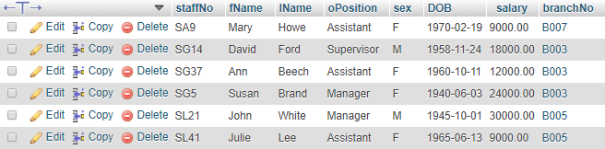
Select * from Staff

Slide 29
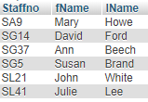
Select Staffno, fName, lName from staff

Slide 30
Salary Average of Staff
SELECT staffNo, fName, lName, (Salary / 12) FROM Staff ;

Slide 31
Staff Salaries (greater than 1000)
SELECT staffNo, fName, lName, salary FROM Staff WHERE salary > 1000 ;

Slide 32
List the addresses of all branch offices in London or Glasgow
SELECT * FROM Branch WHERE city = 'London' OR city = 'Glasgow' ;

Slide 33
List all staff with a salary between £20000 and £30000.
SELECT staffNo, fName, lName, Salary
FROM Staff WHERE salary BETWEEN 20000 AND 30000 ;

Slide 34
List all managers and supervisors
SELECT staffNo,fName,lName,oPosition
FROM Staff WHERE oPosition IN ('Manager','Supervisor') ;

Slide 35
Find all owners with the string ‘Glasgow’ in their address.
SELECT ownerNo, fName, lName, address, telNo FROM PrivateOwner WHERE address LIKE '%Glasgow%' ;

Slide 36
Produce a list of salaries for all staff, arranged in descending order of salary
SELECT staffNo, fName, lName, Salary
FROM Staff ORDER BY salary DESC

Slide 37
How many properties cost more then £350 per month to rent?
SELECT COUNT(*) AS "count"
FROM PropertyForRent WHERE rent > 350 ;

Slide 38
How many different properties were viewed in May 2001?
SELECT COUNT(DISTINCT propertyNo) AS "count“ FROM Viewing WHERE viewDate BETWEEN '2001-05-01' AND '2001-05-31' ;
SELECT COUNT(DISTINCT propertyNo) AS "count“ FROM Viewing WHERE viewDate BETWEEN DATE'2001-05-01' AND DATE'2001-05-31' ;

Slide 39
Find the total of managers and the sum of their salaries.
SELECT COUNT(staffNo) AS "count", SUM(salary) AS "sum“ FROM Staff WHERE oPosition = 'Manager' ;

Slide 40
Find the minimum, maximum, and average staff salary
SELECT MIN(salary) AS "min", MAX(salary) AS "max", AVG(salary) AS "avg" FROM Staff

Slide 41
Find the number of staff working in each branch and the sum of their salaries
SELECT branchNo, COUNT(staffNo) AS "count", SUM(salary) AS "sum“ FROM Staff GROUP BY branchNo ORDER BY branchNo;

Slide 42
For each branch office with more than one member of staff, find the number of staff working in each branch and the sum of their salaries
SELECT branchNo, COUNT(staffNo) AS "count", SUM(salary) AS "sum" FROM Staff GROUP BY branchNo HAVING COUNT(staffNo) > 1 ORDER BY branchNo;

Slide 43
List all staff whose salary is greater then the average salary, and show by how much their salary is greater than the average.
SELECT staffNo, fName, lName, oPosition,
(salary - (SELECT AVG(salary) FROM Staff)) AS salDiff FROM Staff WHERE salary > (SELECT AVG(salary) FROM Staff) ;

